Slide 1
Deep Reinforcement Learning
Dr Shadi Abpeikar
Reference: Sutton, R., Barto, A, 2014, Reinforcement Learning: An Introduction, 2nd Edition, MIT Press; Sewak, Mohit. Deep reinforcement learning. Singapore: Springer Singapore, 2019.

Slide 2
Lecture Overview
Different types of reinforcement learning
Function approximation in reinforcement learning
Deep learning
Deep reinforcement learning

Slide 3
Model-free RL
In model-free reinforcement learning, an agent perceives the world, takes an action, and measures the reward. The agent usually starts by taking random actions and gradually repeats those that are associated with more rewards.
There’s no direct knowledge or model of the world. The RL agent must directly experience every outcome of each action through trial and error.
It is based on the law of effect or behaviourism.
Example: in puzzle box the cat interacted with the puzzle box, it learned the behavioral responses that could help it escape. Over time, the cat became faster and faster at escaping the box. (https://www.youtube.com/watch?v=fanm--WyQJo)
Notes:
Thorndike observed that as the cat interacted with the puzzle box, it learned the behavioral responses that could help it escape. Over time, the cat became faster and faster at escaping the box. Thorndike concluded that the cat learned from the reward and punishments that its actions provided.

Slide 4
Model-based RL
In model-based reinforcement learning, you develop a model of the world. In terms of computer science, it’s a transition probability, how the world goes from one state to another state depending on what kind of action you produce in it.
If you hear about an accident that has blocked the road you usually take to work, model-based RL will allow you to do a mental simulation of alternative routes and change your path. Whereas , With model-free reinforcement learning, the new information would not be of any use to you

Slide 5
Policy
Policy refers to the strategy which applies by the agent to decide on the next action to take.
“It defines the learning agents’ way of behaving at a given time” (Sutton and Barto, 2015)
It applies as a mapping from current state and an action which requires to be taken while on that state of the environment.
Policy might be a simple lookup table or a function. On the other hand, it might be embedded with an extensive computation, such as a search process.

Slide 6
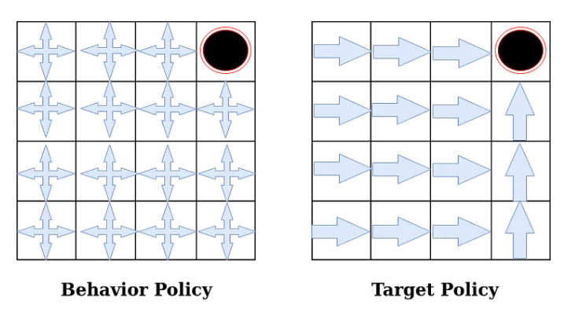
Policy
Target Policy pi(a|s): It is the policy that an agent is trying to learn ( agent is learning value function for this policy).
Behavior Policy b(a|s): It is the policy that is being used by an agent for action select (agent follows this policy to interact with the environment).
https://towardsdatascience.com/on-policy-v-s-off-policy-learning-75089916bc2f

Slide 7
On-Policy vs Off-policy
On-policy: the policy that is used for decision making will be evaluated and improved (SARSA).
[Target Policy == Behavior Policy]
Off-policy: it is independent of agent’s actions. It finds the optimal policy regardless of agents’ motivation (Q-Learning)
[Target Policy != Behavior Policy]

Slide 8
Discrete vs Continuous
This mostly refers to the action space and state space of the reinforcement learning.
A continuous state space requires a continuous action space.
A continuous action space requires a continues reinforcement learning, whereas, a discrete action space requires a discrete reinforcement learning.
Continuous RL: Deep Deterministic Policy Gradient
Discrete RL: Q-Learning and SARSA

Slide 9
Function approximation in reinforcement learning
In previous lecture we used tables to represent the value functions.
To learn more complex problems, the previously experienced states required to be generalized to the ones that have never been seen.
These generalization methods are called “function approximation”.
Value-Prediction
Gradient-Descent Methods
Linear Methods
Radial Basis Functions

Slide 10
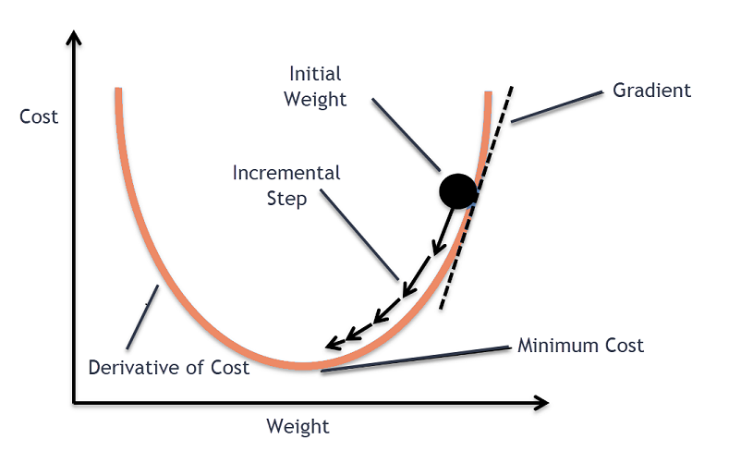
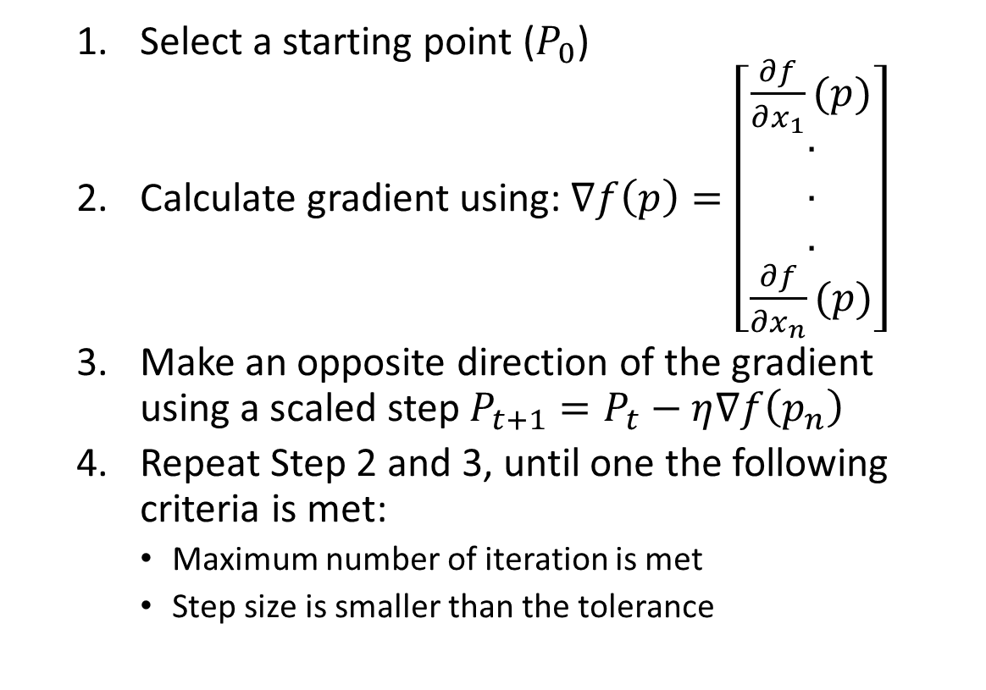
Gradient-Descent Methods
Select a starting point ($P_{0}$)
Calculate gradient using: $∇f\left(p\right)=\left[\begin{matrix}\frac{∂f}{∂x_{1}}(p) \\ \begin{aligned}. \\ . \\ .\end{aligned} \\ \frac{∂f}{∂x_{n}}(p)\end{matrix}\right]$
Make an opposite direction of the gradient using a scaled step $P_{t+1}=P_{t}−η∇f\left(p_{n}\right)$
Repeat Step 2 and 3, until one the following criteria is met:
Maximum number of iteration is met
Step size is smaller than the tolerance

Slide 11
Gradient-Descent Methods in TD Reinforcement Learning
Sutton and Barto, 2015
Notes:
https://www.youtube.com/watch?v=spfpBrBjntg

Slide 12
Neural Network
Sewak Mohit (2019)

Slide 13
Deep Learning
“Deep Learning is a subset of Machine Learning that achieves great power and flexibility by learning to represent the world as nested hierarchy of concepts, with each concept defined in relation to simpler concepts, and more abstract representations computed in terms of less abstract ones.”
Advantages of DL:
Could work with large data size.
Could deal with lack of domain understanding of feature space.
Could deal with complex problems: image processing, and speech recognition
https://towardsdatascience.com/why-deep-learning-is-needed-over-traditional-machine-learning-1b6a99177063

Slide 14
Deep Learning- Deep Neural Network
Sewak Mohit (2019)

Slide 15
Convolutional Neural Network
Sewak Mohit (2019)

Slide 16
Deep Reinforcement Learning
Sewak Mohit (2019)

Slide 17
Deep Reinforcement Learning
Deep Learning
Reinforcement Learning
Deep Reinforcement Learning

Slide 18
Real-life Applications of Deep Reinforcement Learning
Unmanned Vehicles
Robotics
Supply Chain Management
Inventory Management
Dynamic Pricing
https://towardsdatascience.com/drl-01-a-gentle-introduction-to-deep-reinforcement-learning-405b79866bf4

Slide 19
Actor-Critic Reinforcement Learning
Actor: Implements policy to select the action with the most return (long-term reward).
Critic: Provides feedback to the actor based on the worthiness of the selected action.

Slide 20
Actor-Critic Reinforcement Learning
Sewak Mohit (2019)

Slide 21
Actor-Critic Reinforcement Learning
Sewak Mohit (2019)

Slide 22
Deep Reinforcement Learning for Swarming in Robots
Aim: Resolve the challenging task of automatic swarm generation in robots.
Environment: A rectangular area with virtual walls.
State Space: 14 continues parameters for swarm behaviour control.
Action Space: Small changes in state using a specific continuous action space.
Reward: The most important and also hardest part (a knowledge-base from human perception of swarming behaviour)
Abpeikar, Shadi, et al. "Automatic collective motion tuning using actor-critic deep reinforcement learning." Swarm and Evolutionary Computation 72 (2022).

Slide 23
Deep Reinforcement Learning for Swarming in Robots
Abpeikar, Shadi, et al. "Automatic collective motion tuning using actor-critic deep reinforcement learning." Swarm and Evolutionary Computation 72 (2022).

Slide 24
Deep Reinforcement Learning for Swarming in Robots
Reinforcement Learning: Deep Deterministic Policy Gradient
Actor and Critic Networks:
Deep neural network with 14 inputs equal to the state parameters.
Three fully-connected hidden layers of ReLU, tangent hyperbolic, and scaling layer.
Each hidden layer consists of 14 nodes.
Batch size: 1500
Abpeikar, Shadi, et al. "Automatic collective motion tuning using actor-critic deep reinforcement learning." Swarm and Evolutionary Computation 72 (2022).

Slide 25
Deep Reinforcement Learning for Swarming in Robots
Abpeikar, Shadi, et al. "Automatic collective motion tuning using actor-critic deep reinforcement learning." Swarm and Evolutionary Computation 72 (2022).

Slide 26
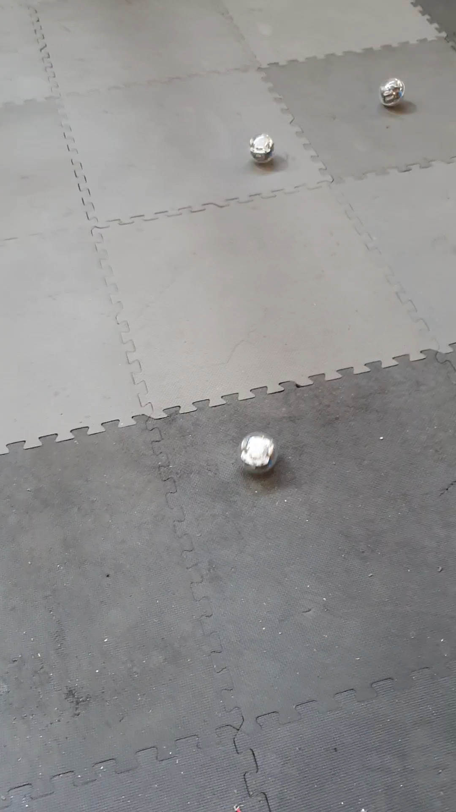
Automatic Swarm Behaviour Generated in Sphero Robots
Abpeikar, Shadi, et al. "Automatic collective motion tuning using actor-critic deep reinforcement learning." Swarm and Evolutionary Computation 72 (2022).

Slide 27
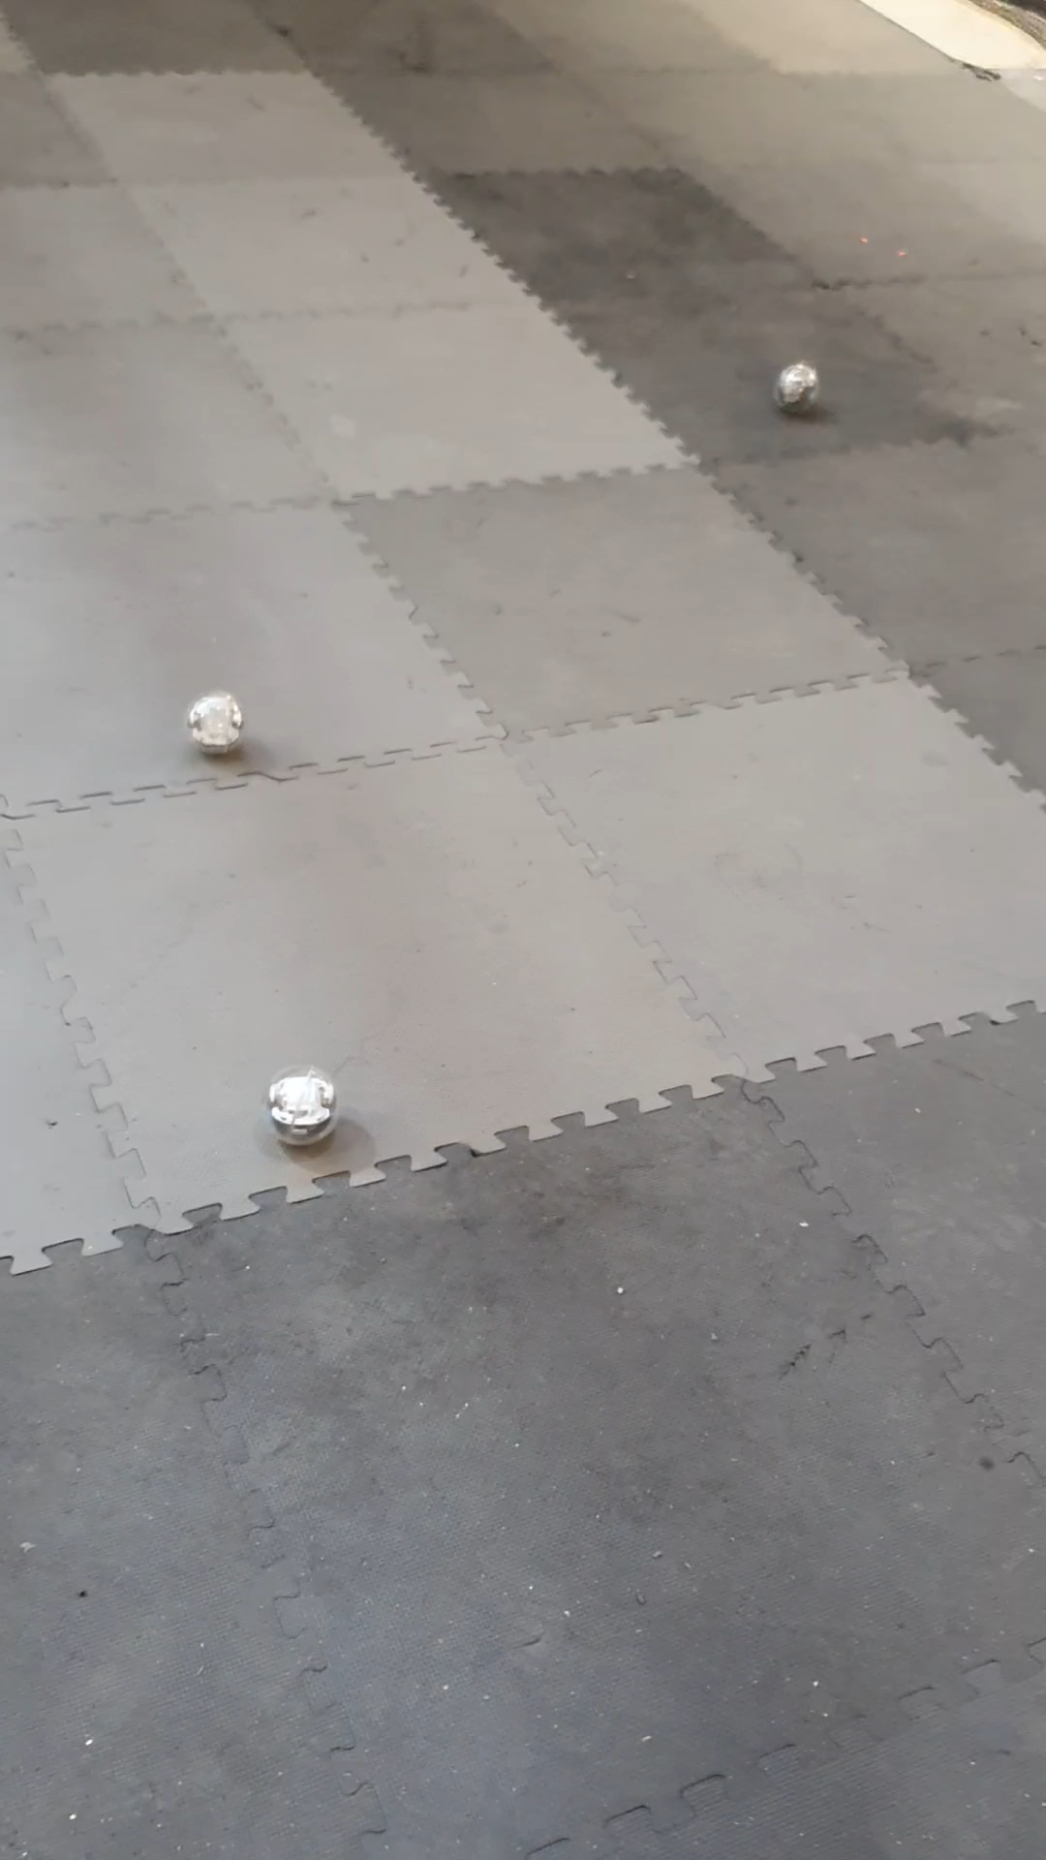
Automatic Swarm Behaviour Generated in Sphero Robots
Abpeikar, Shadi, et al. "Automatic collective motion tuning using actor-critic deep reinforcement learning." Swarm and Evolutionary Computation 72 (2022).

Slide 28
Lecture Summary
After todays lecture you should be able to define and use:
on-policy vs off-policy reinforcement learning
Function approximation using Gradient Descent
Deep neural network
Deep Reinforcement Learning

